Slide 1
Plasma Membrane Structure and Function
Notes:
‹#›

Slide 2
Outline
Phospholipid Bilayer
Fluid Mosaic Model
Membrane Proteins
Diffusion
Facilitated Diffusion
Osmosis
Bulk Transport
Active Transport
Notes:
‹#›

Slide 3
Membrane Functions
Protection
Communication
Selectively allow substances in
Respond to environment
Recognition
Notes:
‹#›

Slide 4
Plasma Membrane
Boundary that separates the living cell from it’s non-living surroundings.
Phospholipid bilayer
Amphipathic - having both:
hydrophilic heads
hydrophobic tails
~8 nm thick
Is a dynamic structure
Phospholipid
Notes:
‹#›

Slide 5
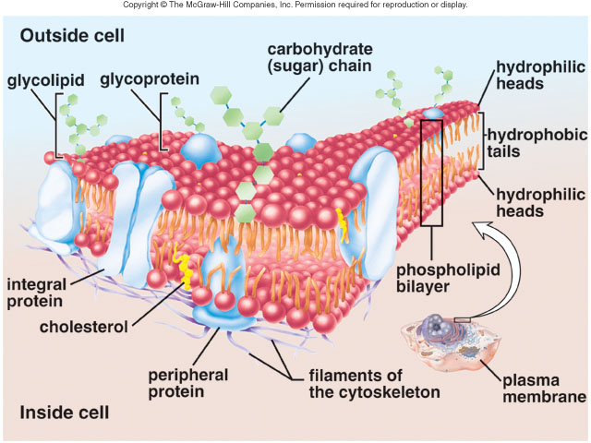
Fluid-Mosaic Model
Notes:
‹#›

Slide 6
Proteins—For Function
Transport
Receptors
Enzymes
Signal Transducers
Support
Notes:
‹#›

Slide 7
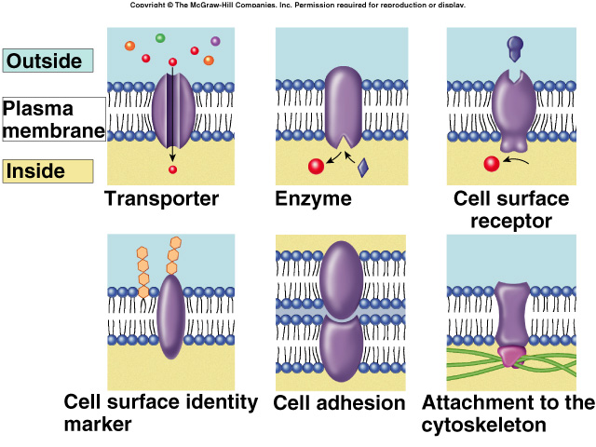
Plasma Membrane Proteins
PROTEINS CAN MOVE IN THE MEMBRANE, TOO!
Notes:
‹#›

Slide 8
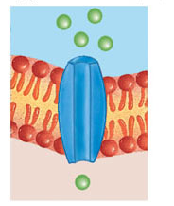
Channel protein
Notes:
‹#›

Slide 9
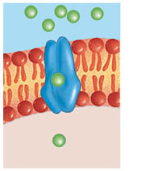
Carrier protein
Notes:
‹#›

Slide 10
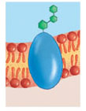
Cell recognition protein
Notes:
‹#›

Slide 11
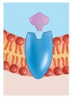
Receptor protein
Notes:
‹#›

Slide 12
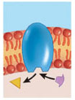
Enzymatic protein
Example of Enzymatic activity associated with a membrane:
G-protein cascade
G-PROTEIN ANIMATION 2
G-protein animation 3
Notes:
‹#›

Slide 13
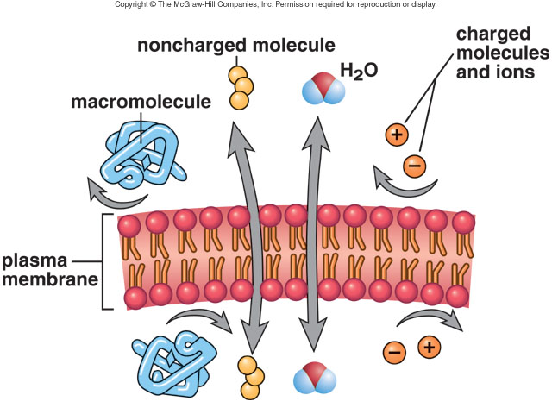
Permeability of the Cell Membrane-
Differentially Permeable
Notes:
‹#›

Slide 14
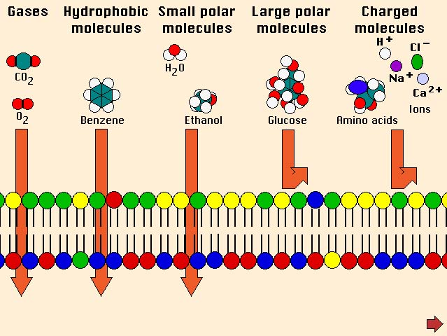
Permeability of the Cell Membrane
Notes:
‹#›

Slide 15
DIFFUSION
Diffusion
  the passive movement of molecules from a higher to a lower concentration until equilibrium is reached.
  How can we explain diffusion?
  Gases move through plasma membranes by diffusion.
Osmosis– A special case of diffusion
Notes:
‹#›

Slide 16
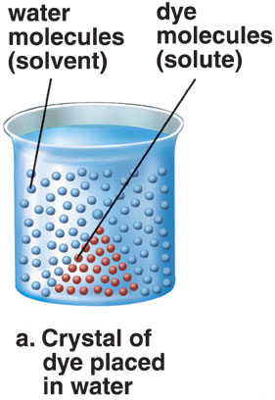
Process of diffusion
Notes:
‹#›

Slide 17
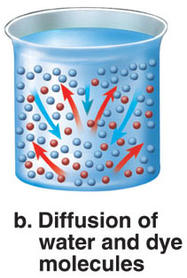
Notes:
‹#›

Slide 18
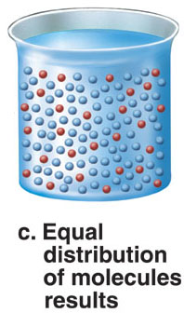
Notes:
‹#›

Slide 19
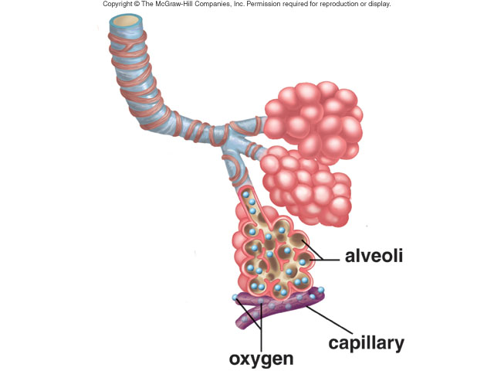
Gas exchange in lungs by diffusion
Notes:
‹#›

Slide 20
Osmosis
The diffusion of water across a differentially permeable membrane due to concentration differences
Notes:
‹#›

Slide 21
TONICITY
Refers to the concentration of SOLUTES
Is a RELATIVE term, comparing two different solutions
Hypertonic
Hypotonic
Isotonic
Notes:
‹#›

Slide 22
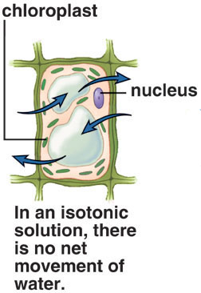
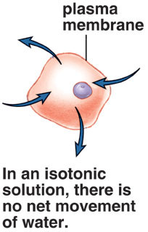
ISOTONIC SOLUTION
Notes:
‹#›

Slide 23
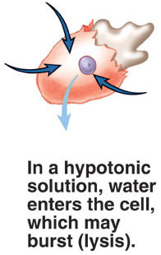
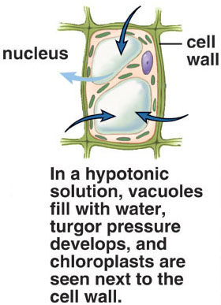
HYPOTONIC SOLUTION
Notes:
‹#›

Slide 24
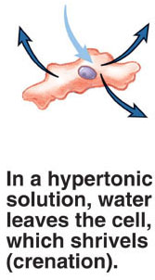
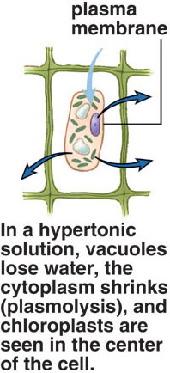
HYPERTONIC SOLUTION
Notes:
‹#›

Slide 25
Carrier Proteins
Function—Transport. Are specific, combine with only a certain type of molecule.
Types
  Facilitated transport--passive
  Active transport—requires energy
Notes:
‹#›

Slide 26
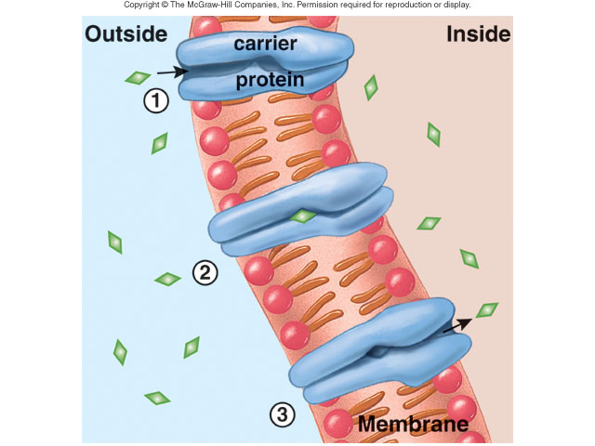
Facilitated Transport
Notes:
‹#›

Slide 27
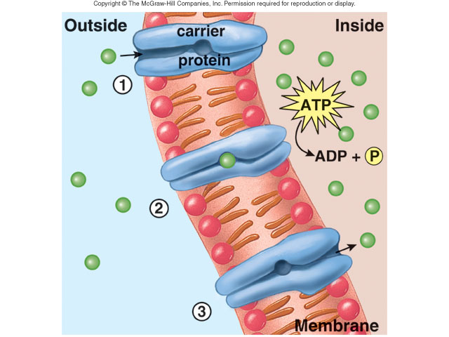
Active Transport
Notes:
‹#›

Slide 28
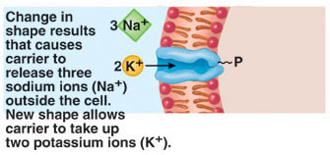
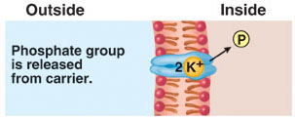
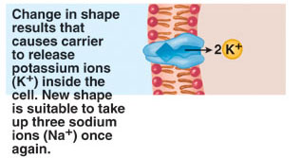
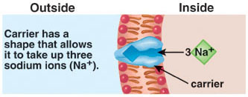
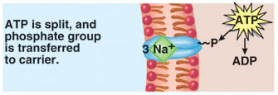
The sodium-potassium pump
Notes:
‹#›

Slide 29
Exocytosis and Endocytosis
Exocytosis---Cellular secretion
Endocytosis—
  Phagocytosis— “Cell eating”
  Pinocytosis– “Cell drinking”
  Receptor-mediated endocytosis-specific particles, recognition.
Notes:
‹#›

Slide 30
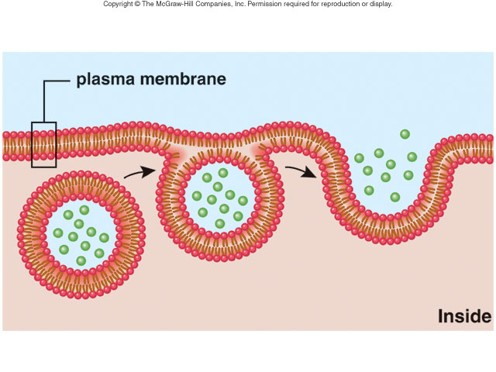
Exocytosis
Notes:
‹#›

Slide 31
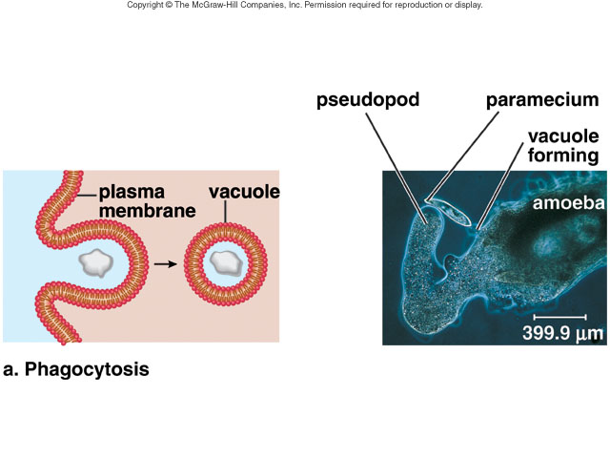
Phagocytosis
Phagocytosis 1
Phagocytosis 2
Notes:
‹#›

Slide 32
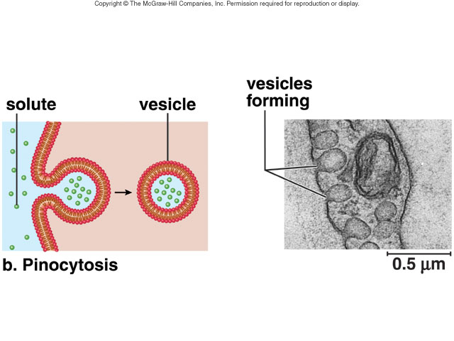
Pinocytosis
Notes:
‹#›

Slide 33
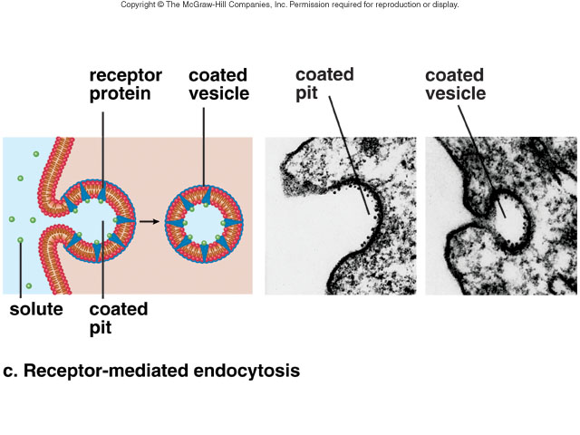
Receptor-mediated Endocytosis
Notes:
‹#›

Slide 34
Thank you
Notes:
‹#›

